Slide 1
User Guide
Apache Traffic Portal

Slide 2
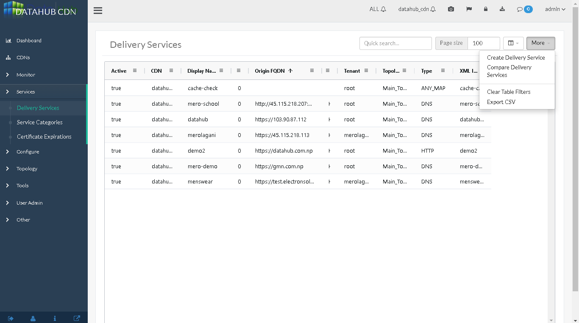
Add A new URL/Delivery service

Slide 3
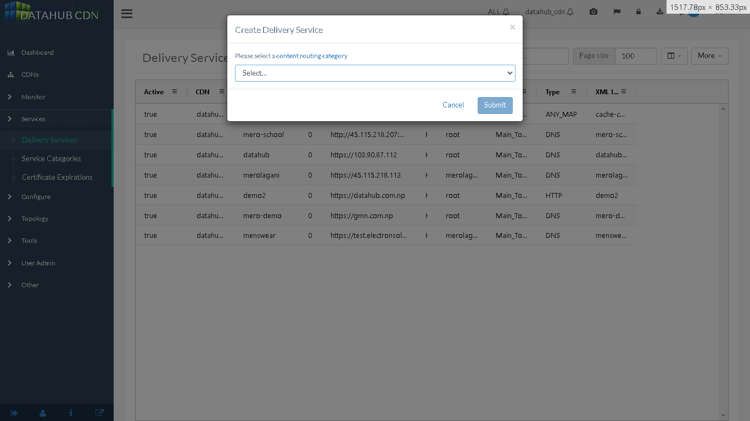
Select the routing service you want to use

Slide 4
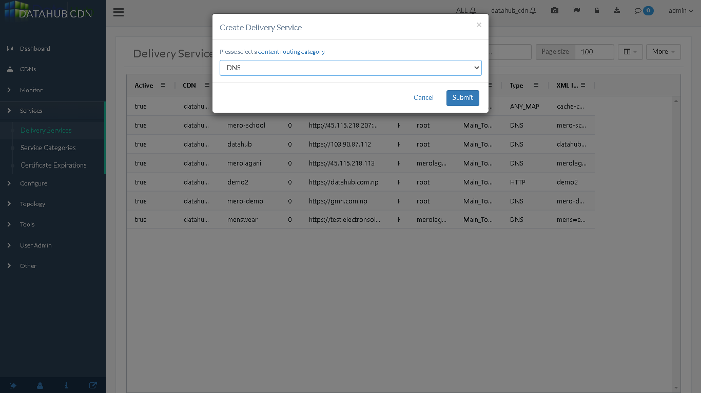
Select the CR type (I chose DNS here)

Slide 5
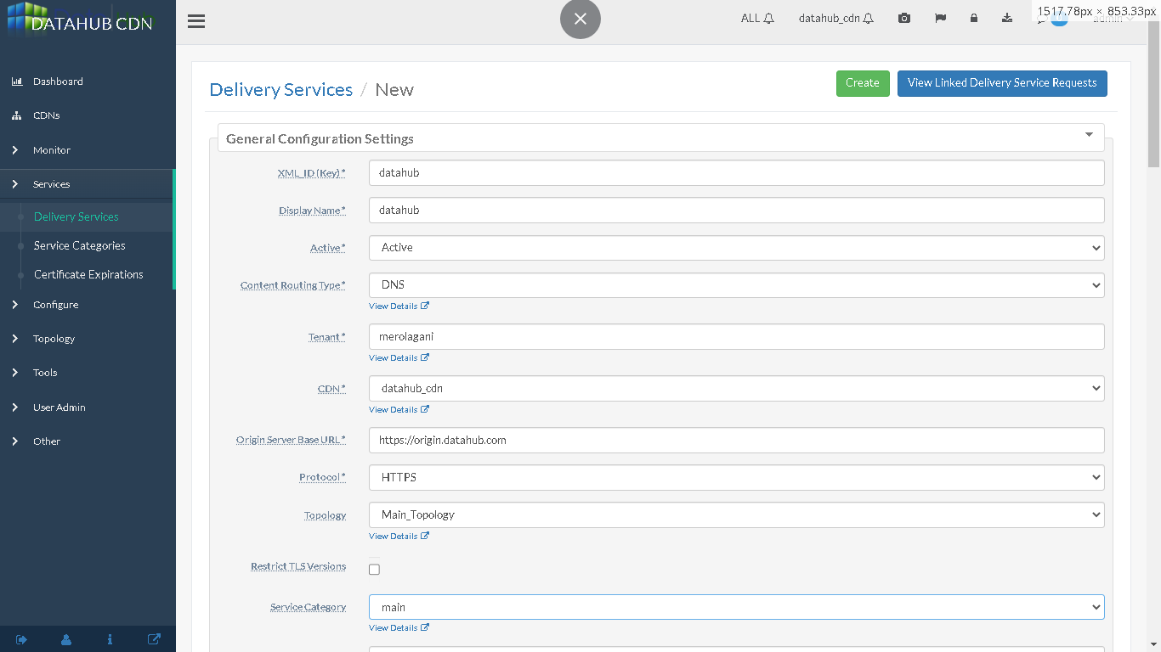
Add Required Information in the delivery service

Slide 6
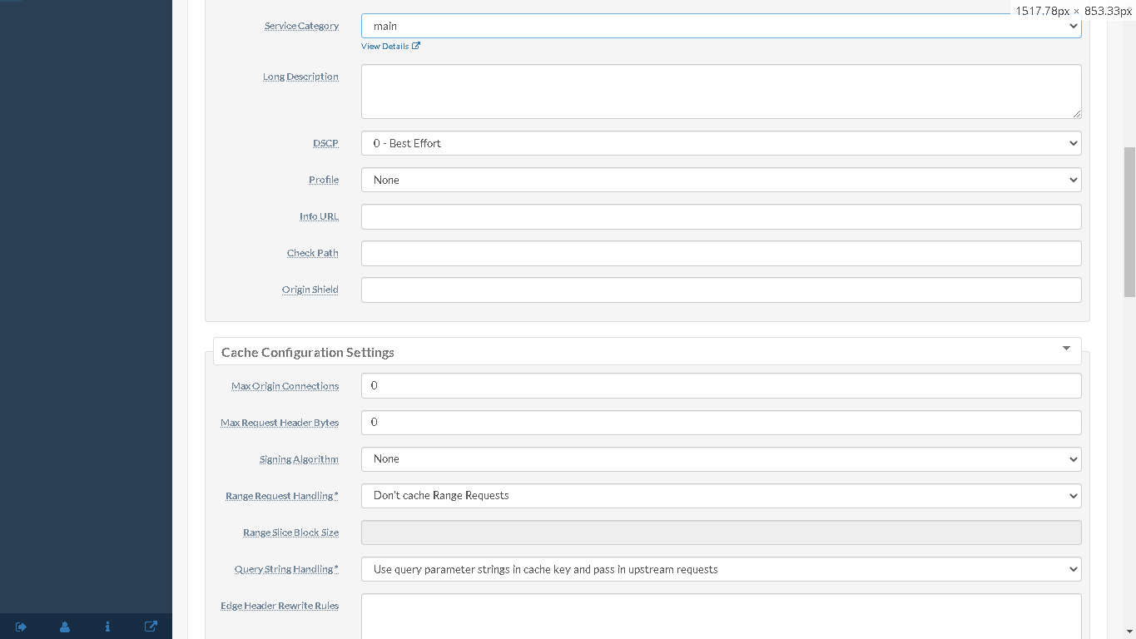
Add Required Information in the delivery service (Cont…)

Slide 7
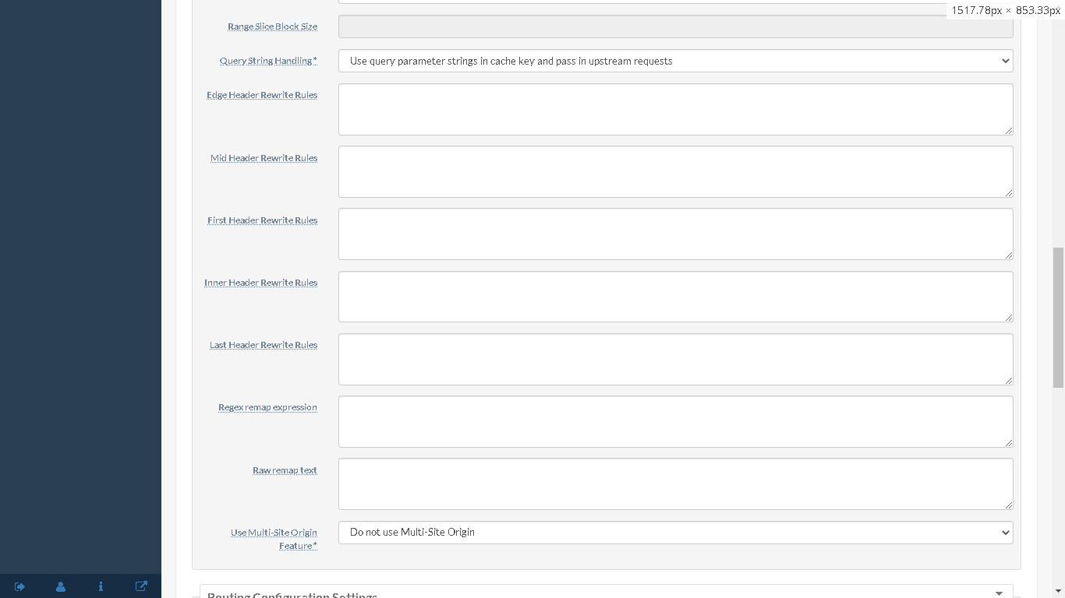
Add Required Information in the delivery service (Cont…)

Slide 8
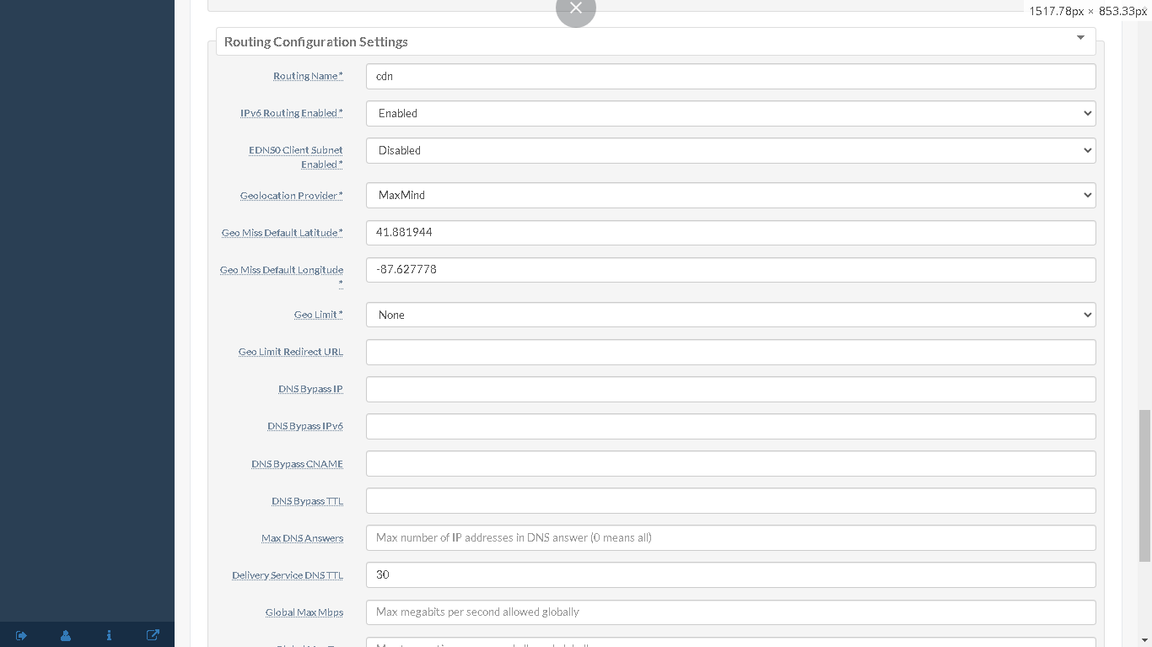
Add Required Information in the delivery service (Cont…)

Slide 9
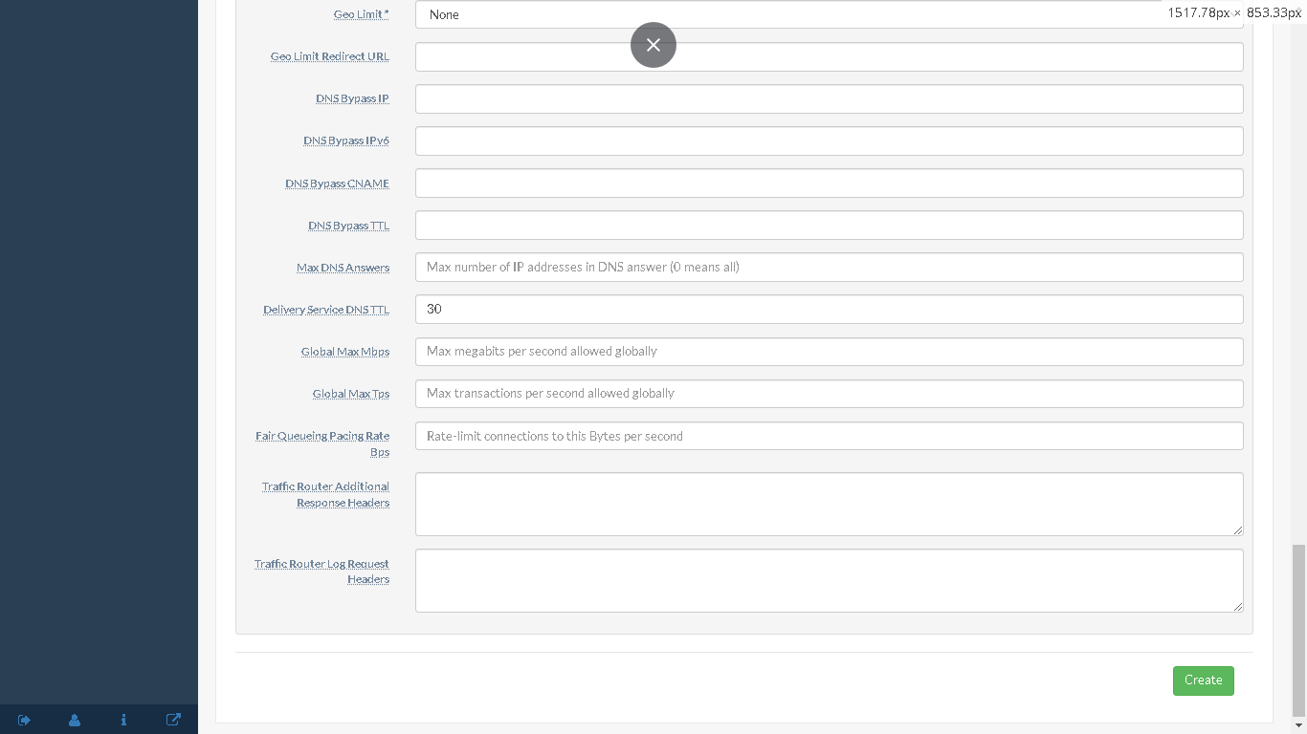
Add Required Information in the delivery service (Cont…) then click save

Slide 10
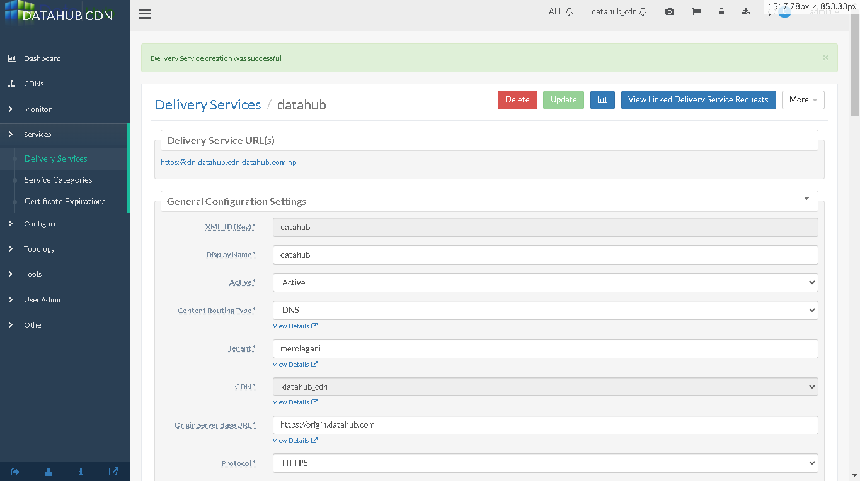
This will add the delivery service and provide a link with the delivery service.

Slide 11
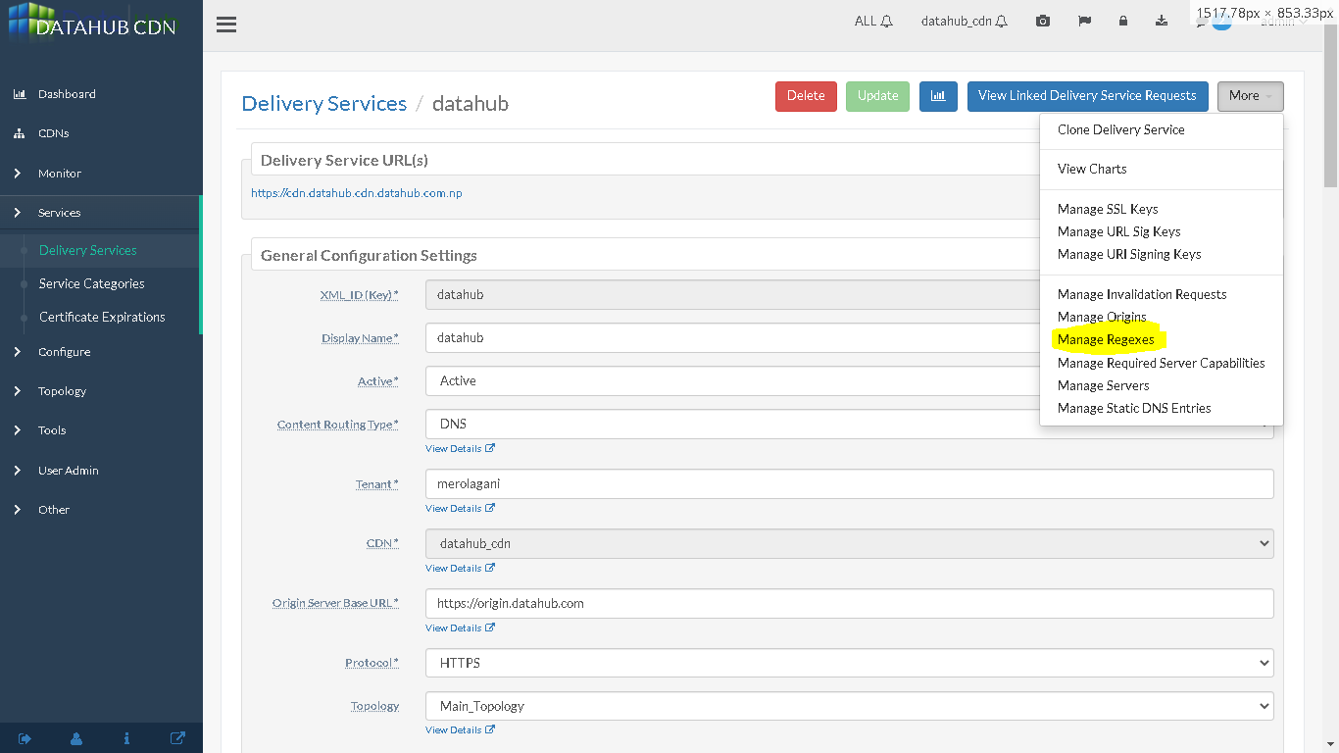
Now to add the regex link

Slide 12
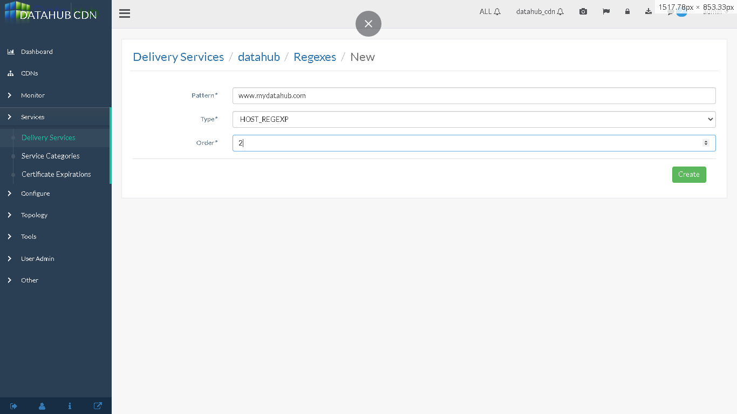
Enter the regex the user would like the cdn to serve

Slide 13
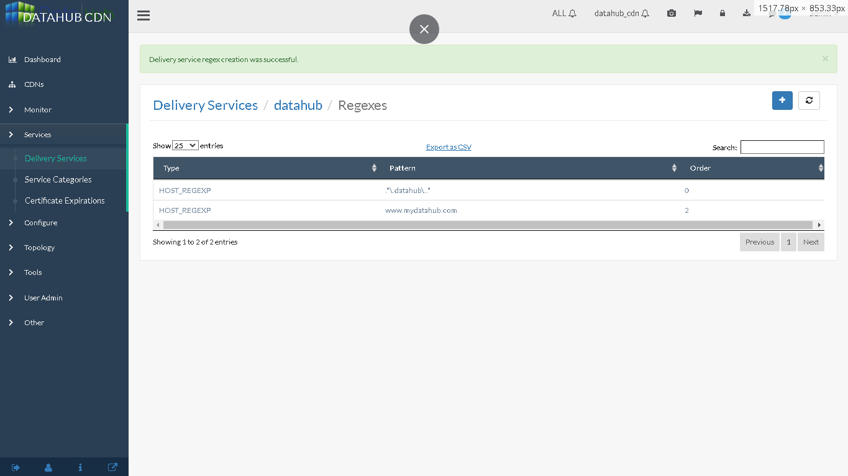
Save the regex

Slide 14
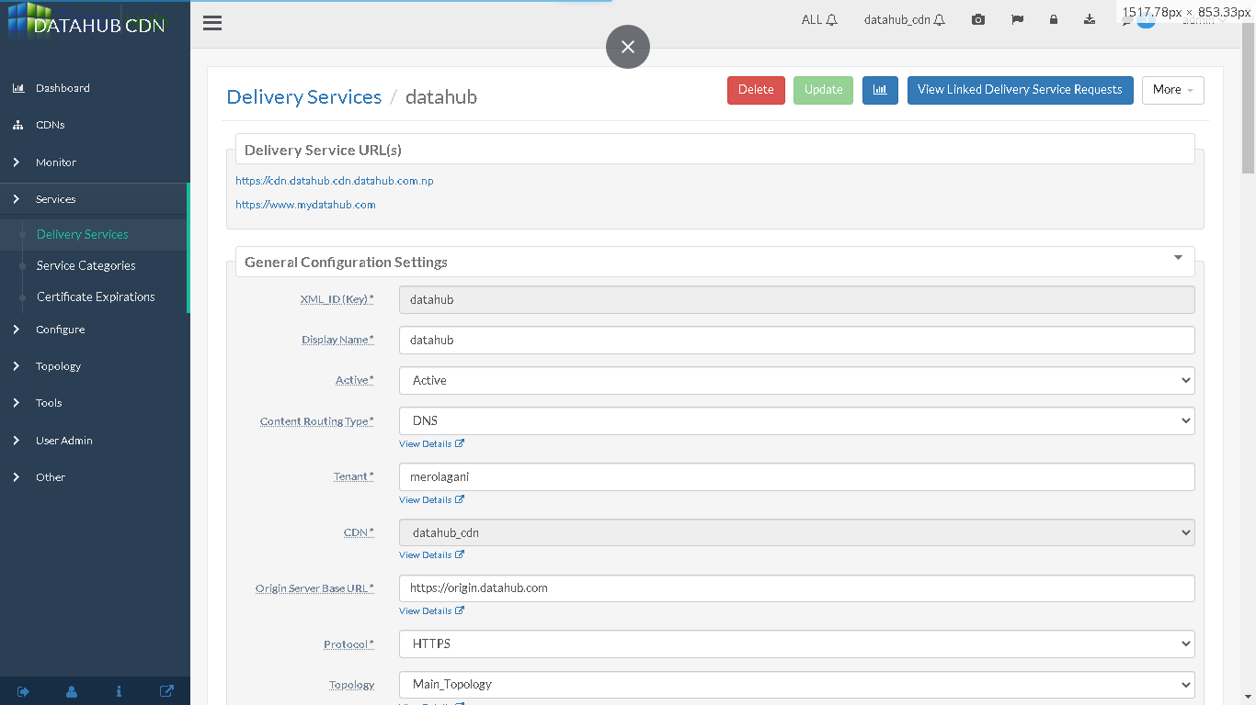
This will also create a regex link (now put a cname in your dns for the upper delivery service)

Slide 15
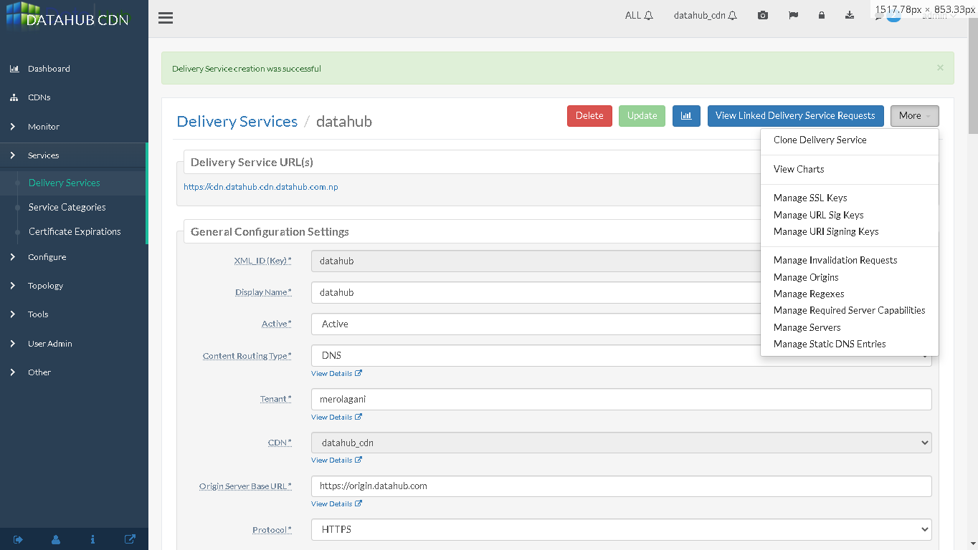
Add ssl keys

Slide 16
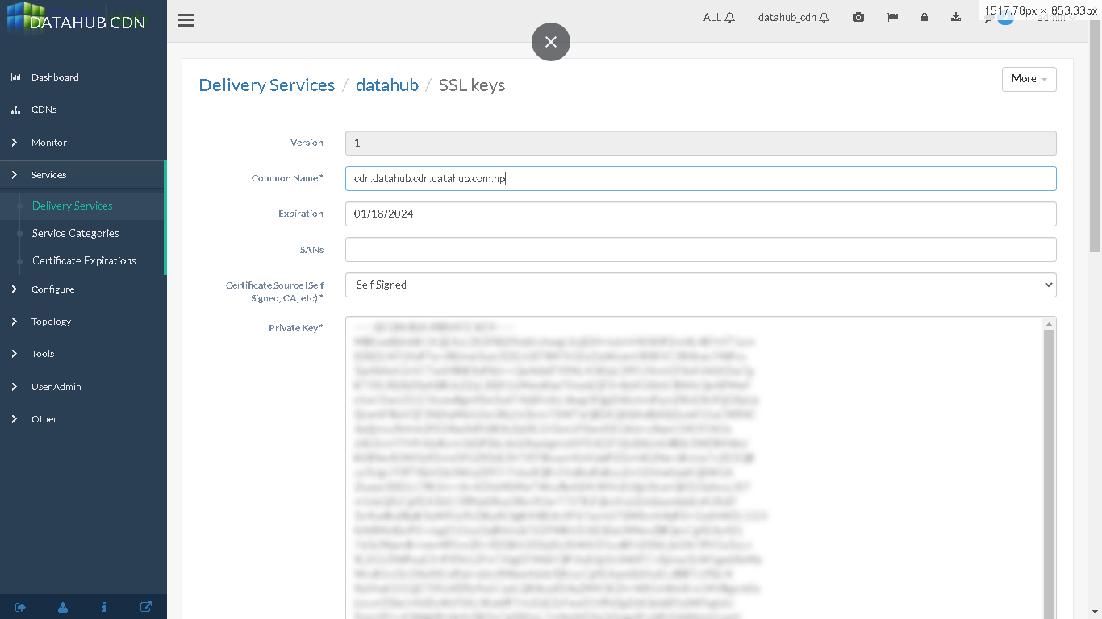
Add certificates and keys here

Slide 17
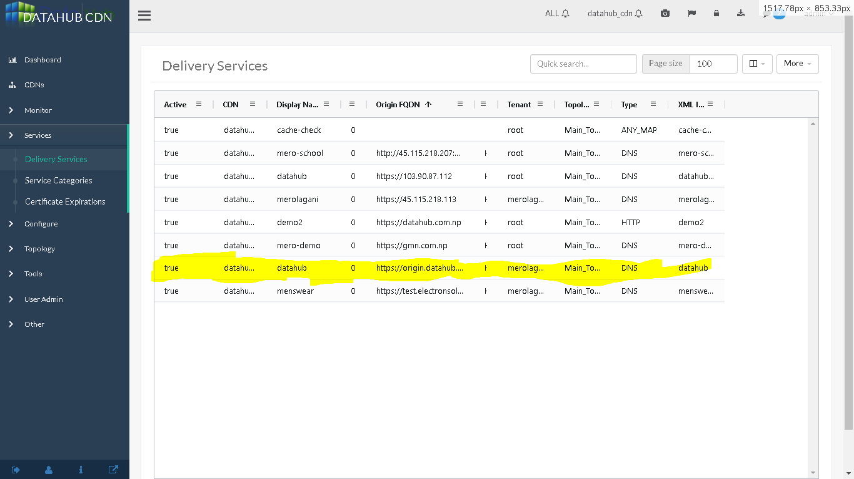
Now you can see the delivery service listed also

Slide 18
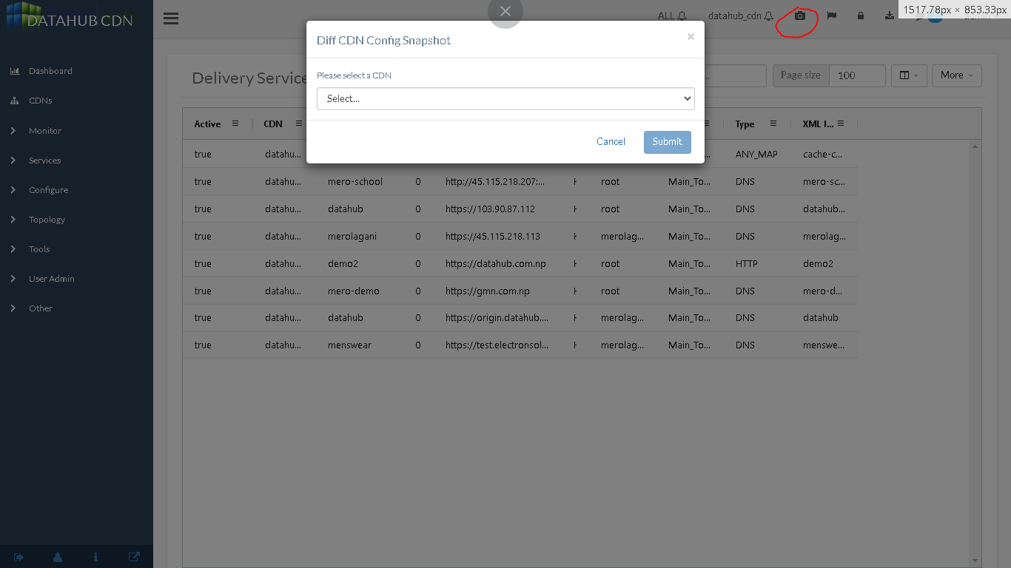
Now take a snapshot by clicking the highlighted button

Slide 19
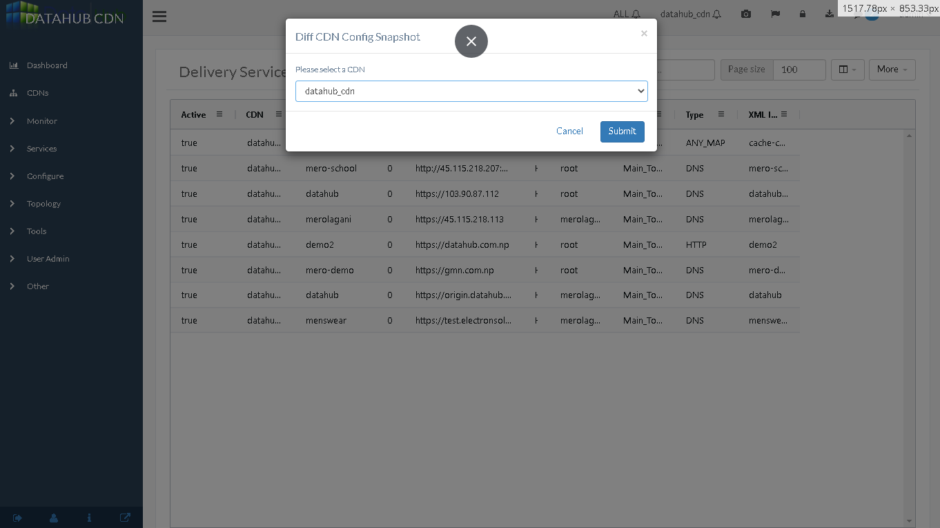
Select the cdn for the snapshot

Slide 20
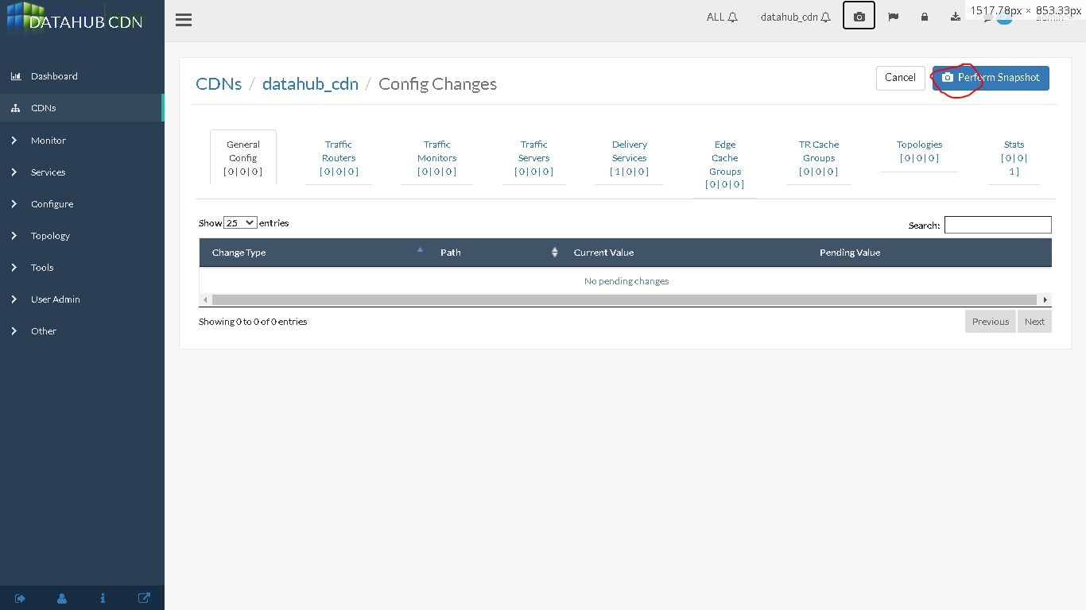
The click the perform snapshot

Slide 21
This lets you onboard new clients for the delivery service.

